Slide 1
Recurrent NN

Slide 2
Introduction
Neural networks have hidden layers. Normally, the state of your hidden layer is based ONLY on your input data. So, normally a neural network's information flow would look like this
input -> hidden -> output
This is straightforward. Certain types of input create certain types of hidden layers. Certain types of hidden layers create certain types of output layers. It's kind of a closed system. Memory changes this. Memory means that the hidden layer is a combination of your input data at the current timestep and the hidden layer of the previous timestep.
(input + prev_hidden) -> hidden -> output
Why the hidden layer? Well, we could technically do this.
(input + prev_input) -> hidden -> output

Slide 3
RNN cont..
However, we'd be missing out. Lets, consider how this plays out. Here, we have 4 timesteps of a recurrent neural network pulling information from the previous hidden layer.
(input + empty_hidden) -> hidden -> output
(input + prev_hidden) -> hidden -> output
(input + prev_hidden) -> hidden -> output
(input + prev_hidden) -> hidden -> output
And here, we have 4 timesteps of a recurrent neural network pulling information from the previous input layer
(input + empty_input) -> hidden -> output
(input + prev_input) -> hidden -> output
(input + prev_input) -> hidden -> output
(input + prev_input) -> hidden -> output

Slide 4
Maybe, if we color things a bit, it would become more clear.
Again, 4 timesteps with hidden layer recurrence
(input + empty_hidden) -> hidden -> output
(input + prev_hidden) -> hidden -> output
(input + prev_hidden) -> hidden -> output
(input + prev_hidden ) -> hidden -> output
.... and 4 timesteps with input layer recurrence....
(input + empty_input) -> hidden -> output
(input + prev_input) -> hidden -> output
(input + prev_input) -> hidden -> output
(input + prev_input) -> hidden -> output

Slide 5
RNN
The idea behind RNNs is to make use of sequential information.
In a traditional neural network we assume that all inputs (and outputs) are independent of each other. But for many tasks that’s a very bad idea. If you want to predict the next word in a sentence you better know which words came before it.
RNNs are called recurrent because they perform the same task for every element of a sequence, with the output being depended on the previous computations.
Another way to think about RNNs is that they have a “memory” which captures information about what has been calculated so far. In theory RNNs can make use of information in arbitrarily long sequences, but in practice they are limited to looking back only a few steps.

Slide 6
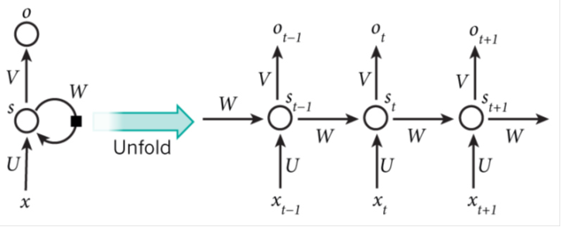
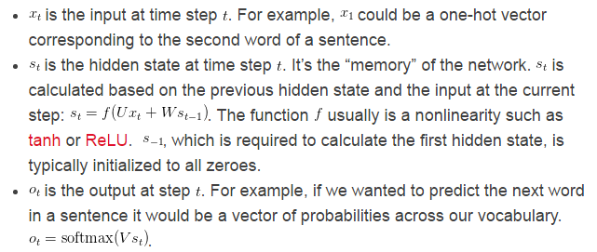
The above diagram shows a RNN being unrolled (or unfolded) into a full network. If the sequence we care about is a sentence of 5 words, the network would be unrolled into a 5-layer neural network, one layer for each word. The formulas that govern the computation happening in a RNN are as follows:

Slide 7
RNN cont..
There are a few things to note here:
You can think of the hidden state S_{t} as the memory of the network. S_{t} captures information about what happened in all the previous time steps. The output at step O_{t} is calculated solely based on the memory at time t . As briefly mentioned above, it’s a bit more complicated in practice because S_{t} typically can’t capture information from too many time steps ago.
Unlike a traditional deep neural network, which uses different parameters at each layer, a RNN shares the same parameters ( U,V,W above) across all steps. This reflects the fact that we are performing the same task at each step, just with different inputs. This greatly reduces the total number of parameters we need to learn.
The above diagram has outputs at each time step, but depending on the task this may not be necessary. For example, when predicting the sentiment of a sentence we may only care about the final output, not the sentiment after each word. Similarly, we may not need inputs at each time step. The main feature of an RNN is its hidden state, which captures some information about a sequence.

Slide 8
LANGUAGE MODELING AND GENERATING TEXT
Given a sequence of words we want to predict the probability of each word given the previous words. Language Models allow us to measure how likely a sentence is, which is an important input for Machine Translation (since high-probability sentences are typically correct). A side-effect of being able to predict the next word is that we get a generative model, which allows us to generate new text by sampling from the output probabilities. And depending on what our training data is we can generate all kinds of stuff. In Language Modeling our input is typically a sequence of words (encoded as one-hot vectors for example), and our output is the sequence of predicted words. When training the network we set o_{t} = x_{t+1} since we want the output at step t to be the actual next word.

Slide 9
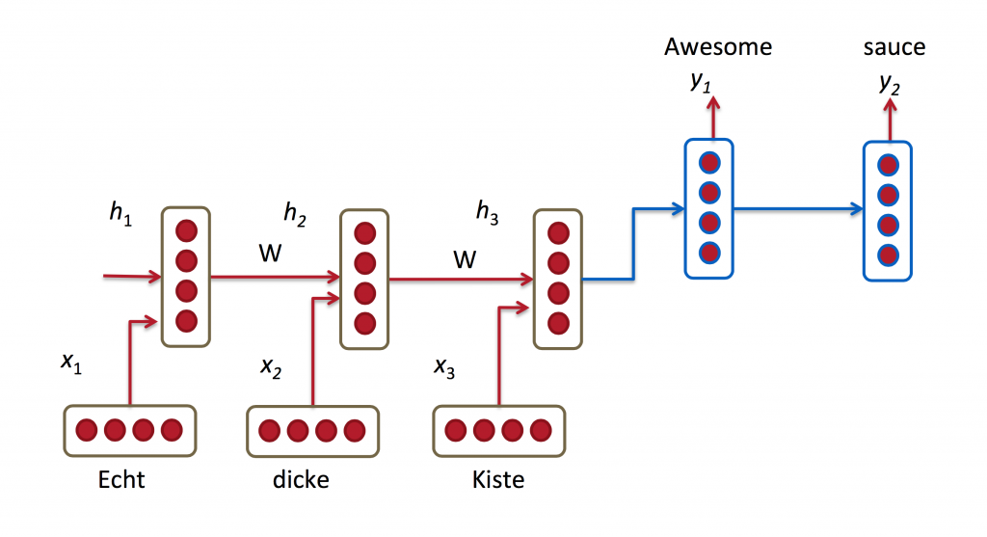
MACHINE TRANSLATION
Machine Translation is similar to language modeling in that our input is a sequence of words in our source language (e.g. German). We want to output a sequence of words in our target language (e.g. English).
A key difference is that our output only starts after we have seen the complete input, because the first word of our translated sentences may require information captured from the complete input sequence.

Slide 10
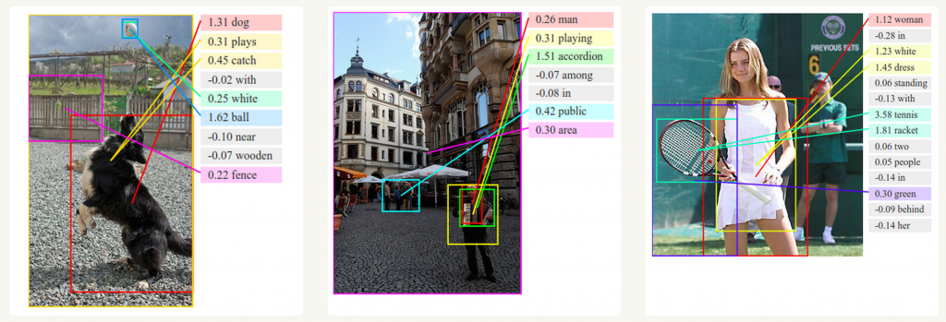
GENERATING IMAGE DESCRIPTIONS
Together with convolutional Neural Networks, RNNs have been used as part of a model to generate descriptions for unlabeled images. It’s quite amazing how well this seems to work. The combined model even aligns the generated words with features found in the images.

Slide 11
Training RNNs
Training a RNN is similar to training a traditional Neural Network. We also use the backpropagation algorithm, but with a little twist. Because the parameters are shared by all time steps in the network, the gradient at each output depends not only on the calculations of the current time step, but also the previous time steps.
For example, in order to calculate the gradient at t=4 we would need to backpropagate 3 steps and sum up the gradients. This is called Backpropagation Through Time (BPTT). The vanilla RNNs trained with BPTT have difficulties learning long-term dependencies (e.g. dependencies between steps that are far apart) due to what is called the vanishing/exploding gradient problem.
There exists some machinery to deal with these problems, and certain types of RNNs (like LSTMs) were specifically designed to get around them.

Slide 12
LSTM
LSTM networks are quite popular these days.
LSTMs don’t have a fundamentally different architecture from RNNs, but they use a different function to compute the hidden state.
The memory in LSTMs are called cells and you can think of them as black boxes that take as input the previous state h_{t-1} and current input x_{t}.
Internally these cells decide what to keep in (and what to erase from) memory. They then combine the previous state, the current memory, and the input. It turns out that these types of units are very efficient at capturing long-term dependencies

